Slide 1
Statistical Reasoning

Slide 2
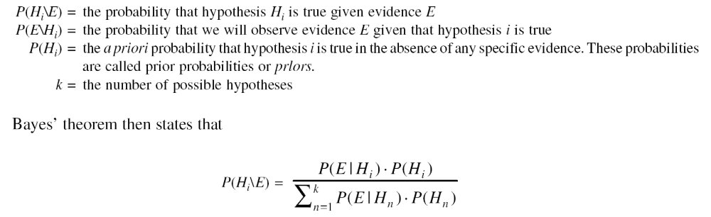
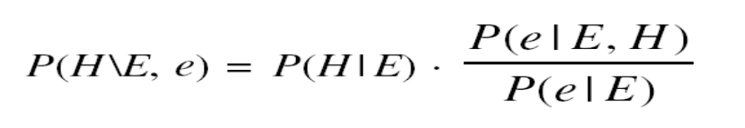
Bayes Theorem
The notion of conditional probability : P(H\E)
Let :
Further, if we add a new piece of evidence, e, then

Slide 3
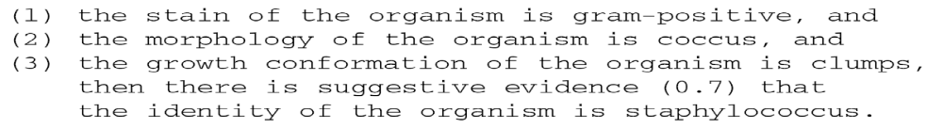
Adding Certainty Factors to Rules
Example of a Mycin Rule :
189

Slide 4
Marie is getting married tomorrow, at an outdoor ceremony in the desert. In recent years, it has rained only 5 days each year. Unfortunately, the weatherman has predicted rain for tomorrow. When it actually rains, the weatherman correctly forecasts rain 90% of the time. When it doesn't rain, he incorrectly forecasts rain 10% of the time. What is the probability that it will rain on the day of Marie's wedding?

Slide 5
Event A₁. It rains on Marie's wedding.
Event A₂. It does not rain on Marie's wedding.
Event B. The weatherman predicts rain.
P( A₁ ) = 5/365 =0.0136985 [It rains 5 days out of the year.]
P( A₂ ) = 360/365 = 0.9863014 [It does not rain 360 days out of the year.]
P( B | A₁ ) = 0.9 [When it rains, the weatherman predicts rain 90% of the time.]
P( B | A₂ ) = 0.1 [When it does not rain, the weatherman predicts rain 10% of the time.]

Slide 6
We want to know P( A₁ | B ), the probability it will rain on the day of Marie's wedding, given a forecast for rain by the weatherman
Even when the weatherman predicts rain, it only rains only about 11% of the time. Despite the weatherman's gloomy prediction, there is a good chance that Marie will not get rained on at her wedding.
P( A₁ | B ) = | P( A₁ ) P( B | A₁ )/P( A₁ ) P( B | A₁ ) + P( A₂ ) P( B | A₂ )
P( A₁ | B ) = | (0.014)(0.9) / [ (0.014)(0.9) + (0.986)(0.1) ]
P( A₁ | B ) = | 0.111

Slide 7

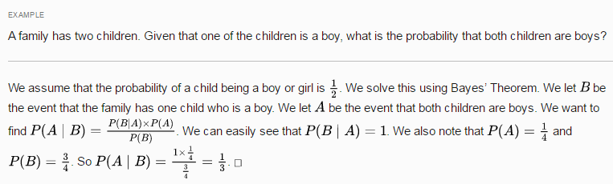

Slide 8
Bayesian belief networks
It is a probabilistic graphical model that encodes probabilistic relationships among a set of variables with their probabilistic dependencies.
This network is used for storing joint probability distribution.
Bayesian network can predict diseases on basis of symptoms.

Slide 9
The bayesian belief network is an acyclic directed graph where nodes of the graph represent evidence or hypothesis and arc connecting two nodes represents dependence between them.
If node having no parent called unconditional node like A, B.
If node having parent called conditional node like C,D.
Node with no children called hypotheses and with children called evidence node.
A
B
C
D

Slide 10
Measures of Belief
190

Slide 11
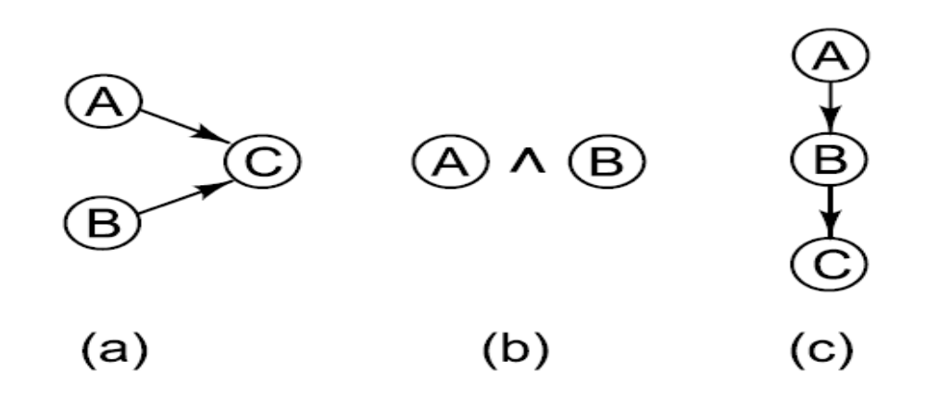
Combining Uncertain Rules
191

Slide 12
Combining Uncertain Rules
Goals for combining rules :
Since the order in which evidence is collected is arbitrary, the combining functions should be commutative and associative.
Until certainty is reached, additional confirming evidence should increase MB (and similarly for disconfirming evidence and MD).
If uncertain inferences are chained together, then the result should be less certain than either of the inferences alone.
192

Slide 13
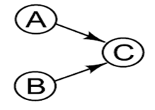
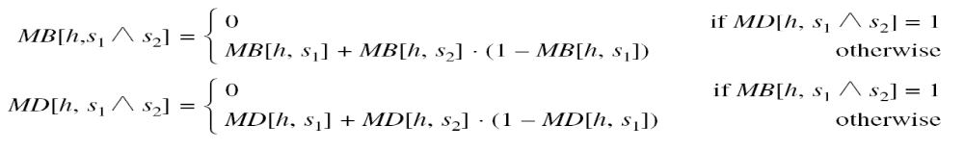
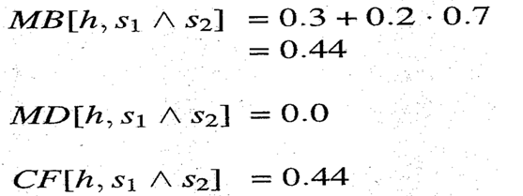


Combining Two Pieces of Evidence

Slide 14

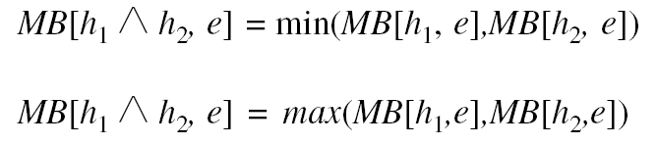
Combining Two Pieces of Evidence
V
193

Slide 15

Combining Two Pieces of Evidence
193

Slide 16
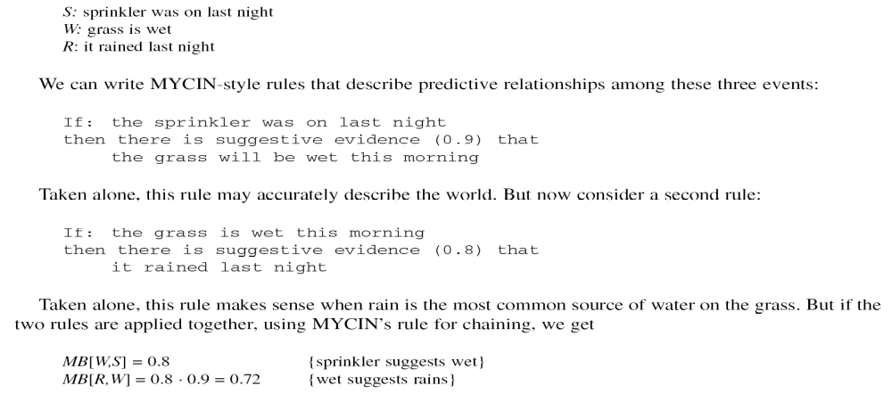
What if the Observations are not Independent
Scenario (c) :
Events :

Slide 17
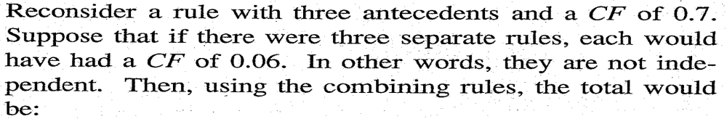
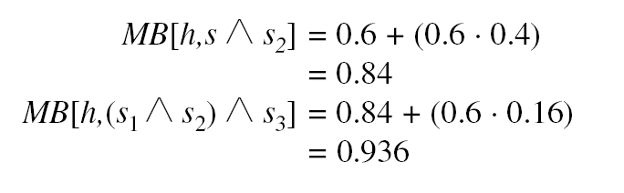
What if the Observations are not Independent
Scenario (a) :
This is very different than 0.7.
196

Slide 18
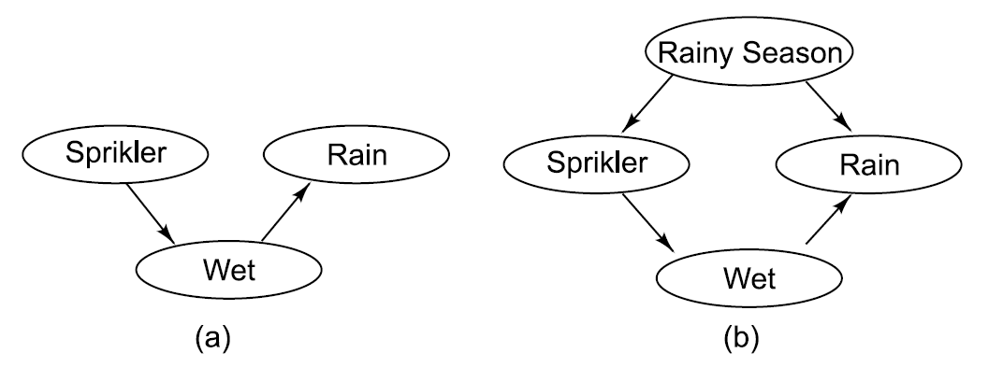
Bayesian Networks : Representing Causality Uniformly
198

Slide 19
Statistical Reasoning
  Bayesian Networks
  Introduction of the new node, that is the Bayesian Network Structure is to make things clear.
  The Graph in figure B is known as DAG – Directed Acyclic Graph that represents causality relationships among the variables. However , we need more information. In particular, we need to know , for each value of a parent node, what evidence is provided about the values that the child node can take on. We create a probability table for that [ 8.3 in text book]
  When the most genuine reasoning does not seem true then we need to use an undirected graph in which the arcs can be used to transmit probabilities in either direction, depending upon where the evidence came from.
  We have to ensure that there is no cycle that exists between the evidences.

Slide 20
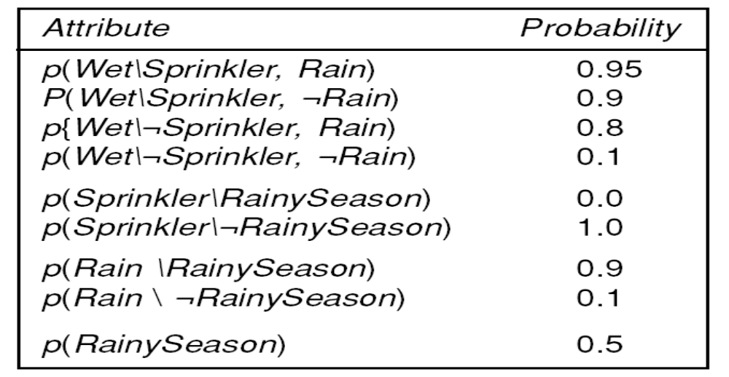
Conditional Probabilities for Bayesian Network
199

Slide 21
Statistical Reasoning
  Bayesian Networks
  Three algorithms are available for doing these computations
  A message-passing method.
  A clique triangulation method.
  A variety of stochastic algorithms. (Markov chain)

Slide 22
Statistical Reasoning
  Bayesian Networks
  The message-passing approach is based on the observation that to compute the probability of a node A given what is known about other nodes in the network. It is necessary to know three things.
  The total support arriving at A from its parents.
  The total support arriving at A from its children.
  The entry in the fixed condition probability matrix that relates A to its causes.
  Clique triangulation method. Explicit arcs are introduced between pair of nodes that share a common descendent.
  Stochastic Algorithm or Randomized Algorithms – The idea is to shield a given node probabilistically from most of the other nodes in the network. These algorithms run faster but may not give correct results.

Slide 23
Statistical Reasoning
  Dempster-Shafer Theory
  Till now, we have talked about individual propositions and assign to each of them a single number of the degree of belief that is warranted given the evidence.
  In Dempster-Shafer Theory we consider sets of propositions and assign to each of them an interval in which the degree of belief must lie.
  [Belief, Plausibility]
  Belief denoted as Bel measures the strength of the evidence in favor of a set of propositions. It ranges from 0( no evidence) to 1(definite certainty)
  Plausibility (Pl) is Pl(s) = 1- Bel(¬s)
  It also ranges from 0 to 1 and measures the extent to which evidence in favor of (not)s , leaves room for belief is s.

Slide 24

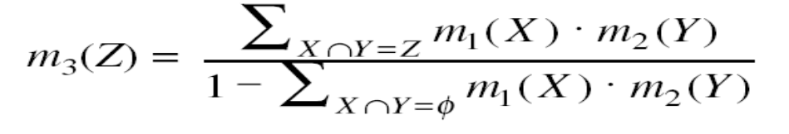
Dempster -Shafer Theory
Let the frame of discernment be an exhaustive, mutually exclusive set of hypothesis.
Let m be a probability density function.
We define the combination m₃ of m₁ and m₂ to be
200

Slide 25

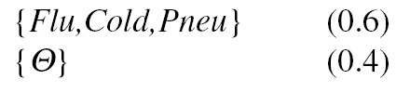
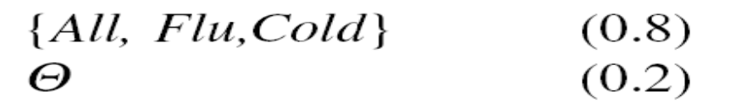
Dempster - Shafer Example
Let be :
All : allergy
Flu : flu
Cold : cold
Pneu : pneumonia
When we begin, with no information m is :
Suppose m₁ corresponds to our belief after observing fever.
Suppose m₂ corresponds to our belief after observing a runny nose.
201

Slide 26
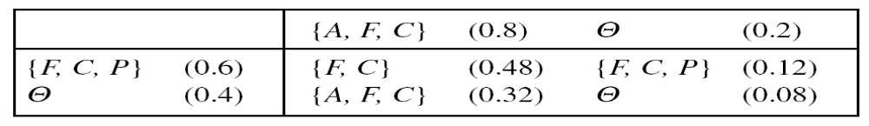
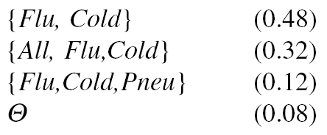

Dempster - Shafer Example (Cont’d)
Then we can combine m₁ and m₂ :
So we produce a new, combined m₃ :
Suppose m₄ corresponds to our belief after that the problem goes away on trips :
202

Slide 27
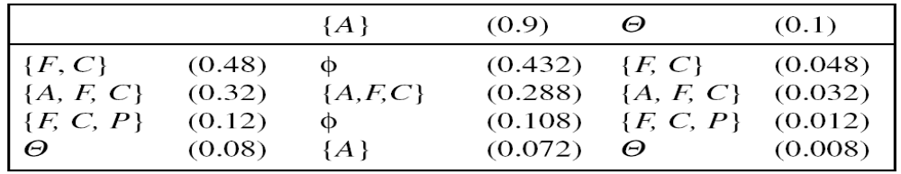

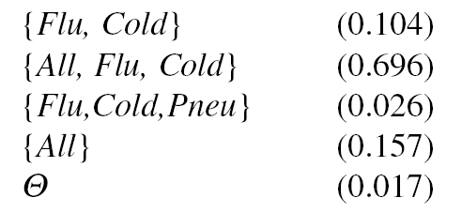
Dempster - Shafer Example (Cont’d)
Then we can combine m₁ and m₂ :
Normalizing to get rid of the belief of 0.54 associated with
gives m₅ :
203

Slide 28


